Slide 1
FastChi
The Parallelized Fast Style Transfer toward Chi-chi video
0656011 Sunner Li
0656126 Liu Yen
0656605 Peter Chuang

Slide 2
Outline
Introduction
Problem statement
Changes made after the proposal
Proposed solution
Evaluation
Related work
Conclusion
Contributions of each member

Slide 3
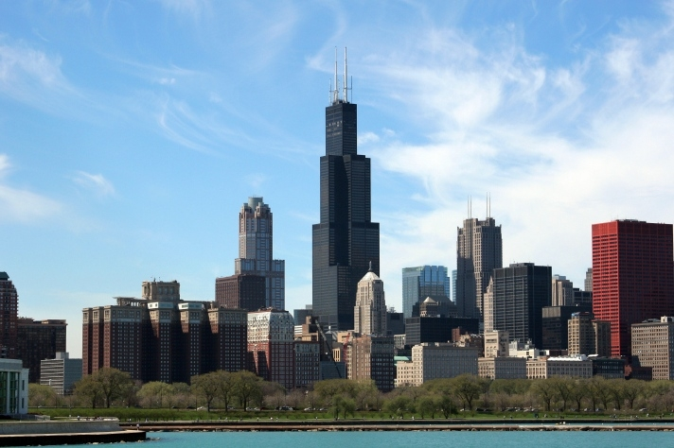
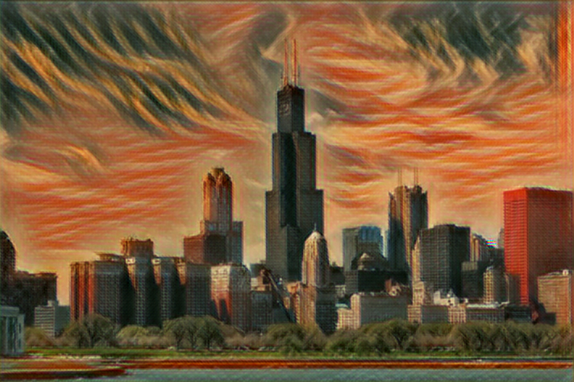
Introduction
Style transform network is a popular issue these years , but there are still some performance problems needs to be enhance.
The original method of our project is use tensorflow to implement the style transfer.
We adjust the network architecture and use multi-GPU to speed up in training stage.

Slide 4
Problem statement
Changes made after the proposal:
At first we decided to speed up the progress of the transformation, but we found that the original network architecture is too large.

Slide 5
Proposed solution
1. we decided to make the tranning progress more efficient, rather than speed up the transformation.

Slide 6
Evaluation

Slide 7
Related work
[1]Leon A. Gatys, Alexander S. Ecker, and Matthias Bethge, “Image Style Transfer Using Convolutional Neural Networks,” In 2016 Computer Vision and Pattern Recognition (CVPR), Las Vegas, Nevada, USA, 27-30 June, 2016, pp. 2414-2423.
[2]Dmitry Ulyanov, Andrea Vedaldi, and Victor Lempitsky, “Instance Normalization: The Missing Ingredient for Fast Stylization,” arXiv: 1607.08022v2 [cs.CV], Sep. 2016.
[3]Justin Juhnson, Alexandre Alahi, and Li Dei-Dei, “Perceptual Losses for Real-Time Style Transfer and Super-Resolution,” arXiv: 1603.08155v1 [cs.CV], March 2016.

Slide 8
Conclusion

Slide 9
Contributions of each member

Slide 10
Q&A

